Slide 1

NASA Strategy for critical data through knowledge management
David Meza – Chief Knowledge Architect
Knowledge Management Technologies Event
June 9, 2015
Notes:
Finding: Knowledge management and transfer within NASA does not always result in critical knowledge from mishaps, accidents, technical investigations, and other important events being incorporated into standards and other documents, or shared in ways that are easily discoverable across NASA. Lessons learned, accidental discoveries, and collateral benefits from all of NASA’s human space flight activity are immeasurable.
Recommendation: The ASAP strongly recommends a formal effort to ensure that NASA prioritizes the most critical knowledge that emerges from events such as mishaps, accidents, and technical investigations. This knowledge should be made highly visible and easily accessible.
Rationale: When one looks at what has been lost or difficult to regain from Apollo, one can see the importance of capturing the wisdom of those who have gone before.

Slide 2


CHALLENGES IN BUILDING KM SYSTEMS
Culture
Getting people to share knowledge
Knowledge evaluation
Assessing the worth of knowledge across the organization
Knowledge processing
Turning tacit knowledge into explicit knowledge
Knowledge Implementation
Organizing knowledge and integrating into your processes
Notes:
Needless to say, there are numerous challenges that one will expect to face when building KM systems.
Here, I have listed four which are considered as universal.
The first challenge is culture. Here, we are not simply referring to culture as in your place of birth, your nationality, etc.
The challenge is more than that. It involves the challenge of getting people to share knowledge, getting people to the point of willing to share what they know. This challenge is more of an art of doing it, rather than technical. For a knowledge developer, one of the primary skills or qualifications is the ability to get the experts share the tacit knowledge related to the domain of the KMS that is to build.
If you are in the position of a manager, what are the ways that you can think of to encourage your subordinates to share what they know with one another??
The next challenge is knowledge evaluation. This involves the assessment of the worth of knowledge (people, files, documents, databases, etc) that exist across the entire organization, in order to determine both domain and scope of KM projects that should be initiated. This will imply a project in itself, the more substantial the larger an organization. This will imply that one has to selective in determining what are relevant knowledge, where they reside, and what benefits they will derive if they are captured and put in a form that can be shared and used.
The third challenge is knowledge processing. By knowledge processing, it is the task of finding out how experts make decision on their tasks based on the knowledge they possess. This is an important challenge that will eventually influence the quality of the KM system that is to build.
Finally, there is the challenge of knowledge implementation. This is most technical among the four challenges, and are related to the activity of organizing knowledge that has been identified and integrating it to the processing strategy being adopted by the organization. Being able to successfully overcome this challenge is like overcoming the last hurdle before final deployment of the KM system.

Slide 3
Organizational Learning
Organizational learning incorporates the sharing of information, knowledge and good work practices that foster an organizational culture committed to continuous improvement.
Notes:
Our primary system of finding and presenting data is not working, we are trying to force all types of data into one presentation method
Exhibit – Exploratory - Explanatory

Slide 4
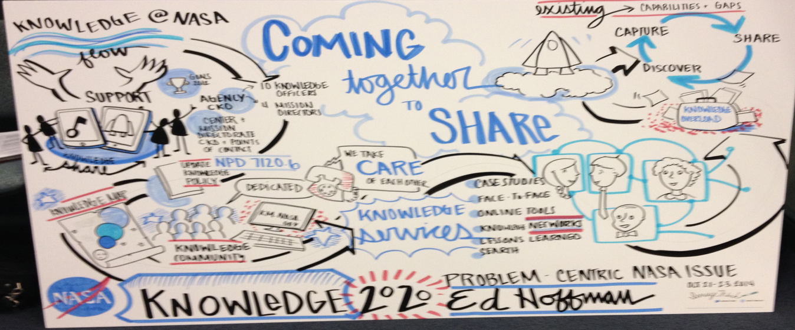
Learning techniques and Tools
Pause and Learn (PAL)
CoP A community of practice
Wiki
Best Practice
Peer Assist (learning before)
After-action Review (AR) (learning during)
Retrospect (learning after)
Knowledge Asset
Notes:
Pause and Learn (PAL) The after action review is currently being used within other NASA organizations under the PAL process. Similar to the after-action review or hot wash, the idea is to create a learning event at the end of selected critical activities in the life of a project. These learning events are facilitated and incorporate the following principles:
CoP A community of practice or network is a group of people who freely share ideas, experiences, and solutions in a culture of trust and collaboration that breaks down organizational barriers. Members of a community are informally bound by what they do together – from engaging in lunchtime discussions to solving difficult problems – and by what they have learned through their mutual engagement in these activities. A community exists to enhance the performance of its members by
Wiki Wikis are seen as the natural collaborative complement to the secure CoPs. While CoPs provide outstanding functionality for project teams and communities of interest, they are not designed first and foremost to support hyperlinked, configuration-managed content development. Wikis are webbased tools that provide a collaborative group authoring capability. Wiki technology, along with other organizational and individual behavioral shifts, will provide the way forward in enhancing efficiency and effectiveness. Wikis are highly flexible, powerful, web-based environments that allow community members to collaborate in the development of narrative "pages" representing the "knowledge or truth" on a given topic (as defined by the community of collaborators).
Best Practice
Peer Assist (learning before): A Peer Assist is a meeting or workshop where people from various business units share their experience, insights, and knowledge with a team that has requested some help and assist in applying help in the new context.
After-action Review (AR) (learning during): An AR is a quick and simple team learning process held after every identifiable team event. An AR is designed to quickly identify key lessons for both the team and individuals and to build trust and confidence among team members.
Retrospect (learning after): A Retrospect is a team meeting called after completion of a piece of work. The objective of a Retrospect is to capture the new knowledge of the team.
Knowledge Asset: Organizes relevant explicit and tacit knowledge into critical key learnings arising from a learning cycle. Not a cookbook but a means to get you to think differently about addressing a challenge or solving a problem. Supported and maintained by a Community of Practice it proves context, performance results, compelling stories, reusable artifacts and links to individuals who know

Slide 5
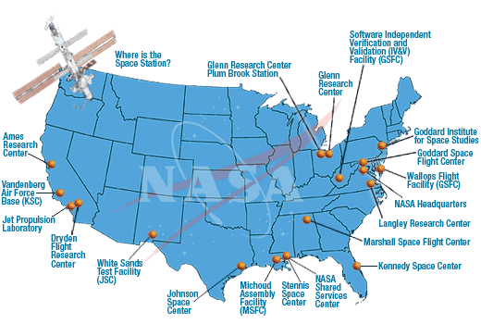
Current Situation
Hundreds of millions of documents, reports, project data, lessons learned, scientific research, medical analysis, geo spatial data, IT logs, etc., are stored nation wide
The data is growing in terms of variety, velocity, volume, value and veracity
Accessibility to Engineering data sources
Visibility is limited
Access to end users for use case development
How do we turn the data into Knowledge?

Slide 6
Accessibility and Visibility
Identify and Prioritize Agency Data types, repositories, uses and interaction
Identify User search preference and habits
Develop Search use cases
Review and evaluate search methods
Semantic
Faceted
Computational
Cognitive
Natural Language query
Explore Presentation Mechanisms
Notes:
Our primary system of finding and presenting data is not working, we are trying to force all types of data into one presentation method
Exhibit – Exploratory - Explanatory

Slide 7
Key Takeaways
There is No One Solution
Data Driven Visualization
Master Data Management Plan is essential
Structure
Format
Metadata
Identify Critical Data
Develop Standards for Government and Contractor created data
Content Management
Storage
Accessibility
We are losing vast amounts of critical data
Notes:
Our primary system of finding and presenting data is not working, we are trying to force all types of data into one presentation method
Exhibit – Exploratory - Explanatory

Slide 8
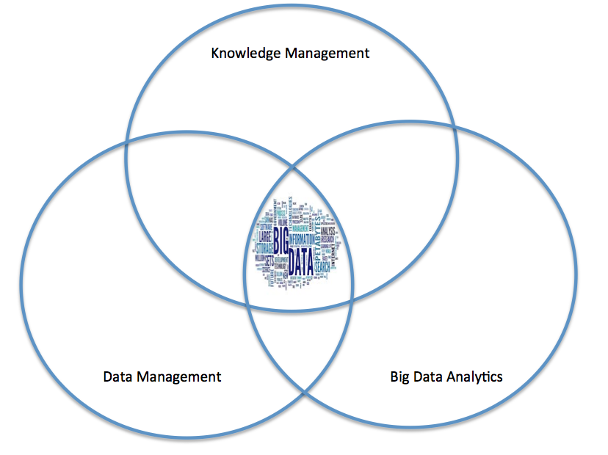
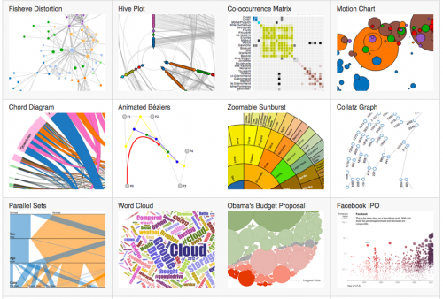
Approach
To convert data to knowledge a convergence of Knowledge Management,
Data Management and Big Data Analytics is necessary

Slide 9
Strategy
Data Management
Framework for setting common procedures and formats for creating and storing data
Big Data Analytics
Provides tools and methodology to convert data into knowledge
Knowledge Management
Tacit to explicit, Search, Business Intelligence
Notes:
Data Management - Improves accessibility, Increase likelihood of visibility, Streamlines development of visualization
Big Data Analytics
Provides Common Toolset and Expertise
R Statistical Programming
SAS
Mathematica
Predictive Modeling
Decision Trees
Neural Nets
Regression
Analytical Capabilities
Natural Language Processing
Topic Modeling
Text Analytics
Search Algorithms
Knowledge Management
Turns tacit knowledge in to explicit knowledge
Makes explicit knowledge retrievable
Improve data identification and capture
Data Analysis and Search
Develops the Business Intelligence platform for visualization

Slide 10
End User is the Priority
Their primary concern is having access and visibility to critical data as near real time as possible
Visualization is the KEY to meeting their needs

Slide 11
Emphasis on Visual Analytics
Visual Analytics shortens the time frame for end users to find information
Helps users make connections between data
Anticipating their needs through predictive modeling
Improves Risk based decisions

Slide 12
Available Tools
MapReduce
NoSQL databases
Neo4j (graph database), mongoDB (document database)
Visibility
Semantic search, cognitive search, computational search, faceted search
Analytics
Text Analytics, Natural language processing, R Statistical Programming, SAS, Mathematica, Probabilistic Graph Models
Visualization
Visual Analytics, Shiny, D3, Tom Sawyer

Slide 13
Examples

Slide 14
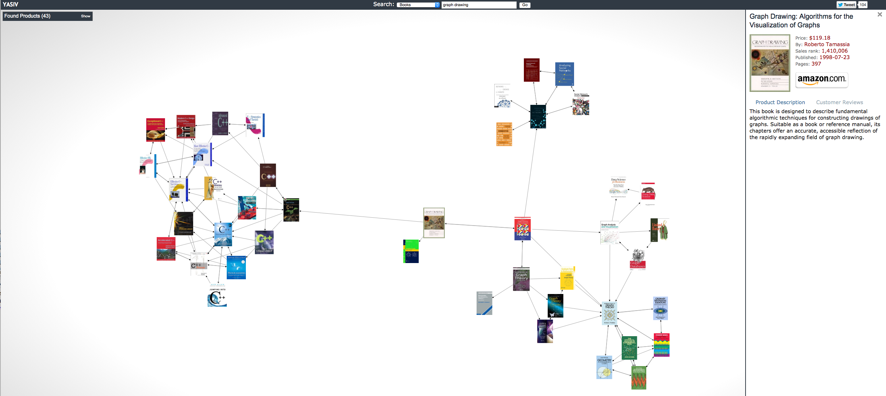
Find a Document…
Social Networks
Programming
Graph Visualization
Graph Drawing
Graph Theory

Slide 15
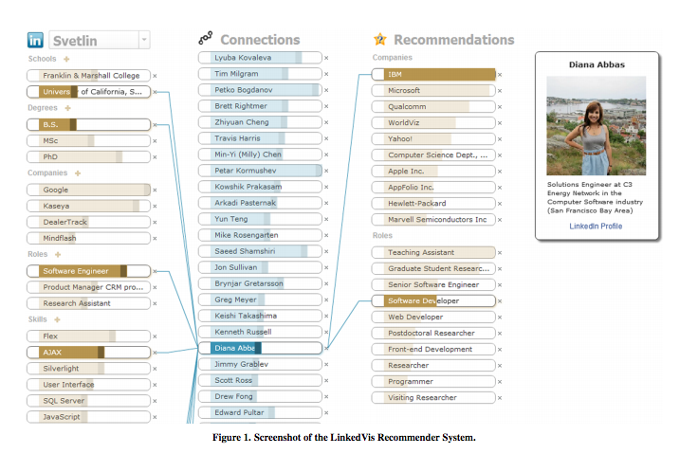
Find Experts…
Source: http://cs.ucsb.edu/~jod/papers/C-6-LinkedVis-IUI2013.pdf

Slide 16
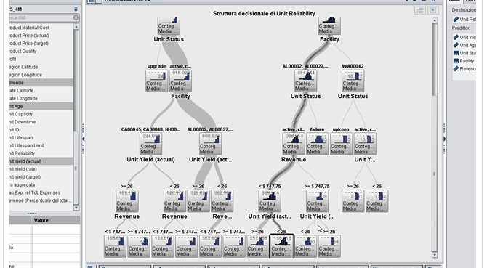
Make decisions…

Slide 17
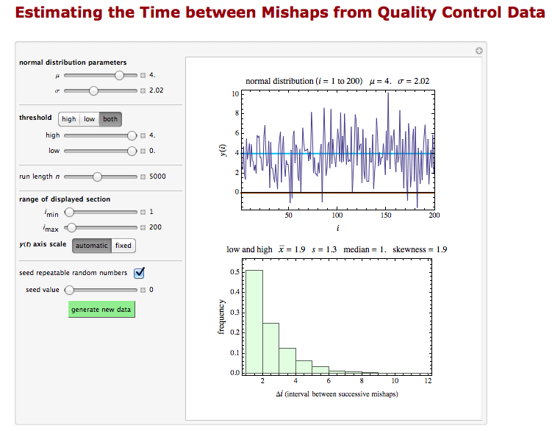
Interactive Data Reports

Slide 18
Knowledge Discovery Through Topic Modeling
David Meza - Chief Knowledge Architect
Text Analytics World 2015 – San Francisco

Slide 19

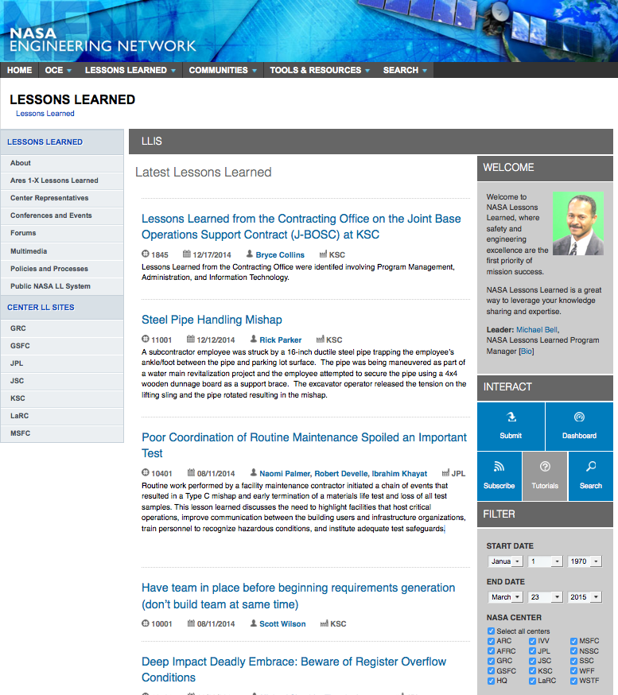
Lesson learned database
2031 lessons submitted across NASA. Filter by date and Center only.
Useful information stored in database.
Notes:
The database was not being used on a regular basis to extract lesson and when it was users complained on how difficult it was to find appropriate lessons. They had to read through too many lessons, wasting precious project time. Users could only filter by date or Center, even though the lesson contained other useful information, such as, category, safety related, program or project phase, directorate etc.
Fortunately the data set contained substantial metadata, providing opportunities to enhance the exploration of the corpus through the generated topics models. Late we will demonstrate how to find documents quickly and their association to the metadata.

Slide 20
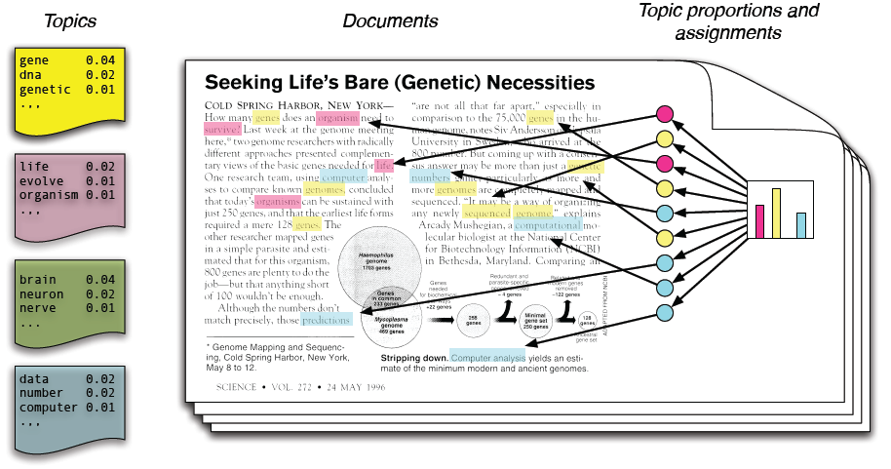
Topic modeling
LDA Model from Blei (2011)
Topic models are based upon the idea that documents are mixtures of topics, where a topic is a probability distribution over words.
Blei, David M. 2011. “Introduction to Probabilistic Topic Models.” Communications of the ACM.
David Blei homepage - http://www.cs.columbia.edu/~blei/topicmodeling.html
Notes:
Topic modeling provides an algorithmic solution to managing, organizing and annotating large archival text. The annotations aid you in tasks of information retrieval, classification and corpus exploration
Topic models provide a simple way to analyze large volumes of unlabeled text. A "topic" consists of a cluster of words that frequently occur together. Using contextual clues, topic models can connect words with similar meanings and distinguish between uses of words with multiple meanings. For a general introduction to topic modeling, see for example Probabilistic Topic Models by Steyvers and Griffiths (2007).
In machine learning and natural language processing topic models are generative models which provide a probabilistic framework for the term frequency occurrences in documents in a given corpus.

Slide 21
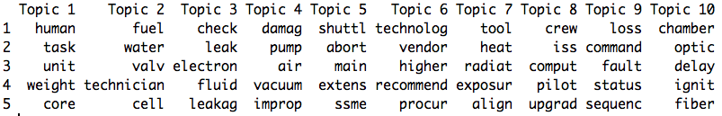
Topic Modeling Process Steps
Create the Document Term Matrix
Store the word frequency per document
Create the Model
Uses LDA to assign each document to a topic
Explore your model
Uncover hidden associations
Using the tm package, create the corpus from the source
Create the document term matrix, reducing to words occurring in at least five documents
Notes:
The tm package, which stands for text mining, is used in this code import a documents into a corpus object. The function can import PDFs, web data and text files. In this case, I imported over 2000 lessons from a csv file. Once the corpus is created, in order to do the LDA , you will need to create a Document Term Matrix. This is done by using the Document Term Matrix function from the tm package. The function will read your corpus, preprocess the data, based on the options you set, returning the matrix. In the highlighted code, I pre-processed the text, by stemming, removing stop words, keeping words with a length of at least 3 characters, and removing numbers and punctuation. The document term matrix displays the terms within each document and can be highly sparse. To Reduce the size, we reduced the DTM to words that occurred in at least five documents.
Once the model is generated, you can extract values and begin exploring the data. In this slide the terms function from the topic model package will display the n number of terms for each topic, where n is number of terms to display. In this example, 5 terms were selected. The terms provide you with an idea of the topic theme. Topic 1 contains the terms pressure, tank, propellant, valve, and fluid, giving an indication this theme is most likely about pressure valves on propellant tanks. An end user who is looking for lessons pertaining to valves, tanks or fuels may want to go to the documents in topic 1 or 22, which also has similar words. But how do we know which documents to read?

Slide 22
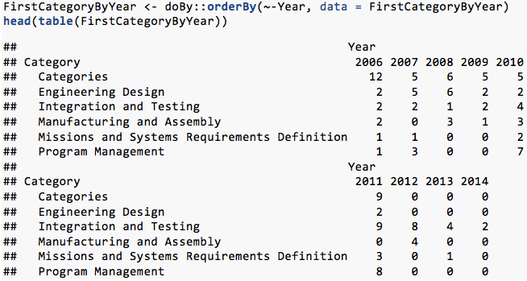
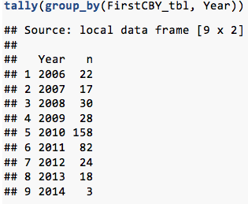
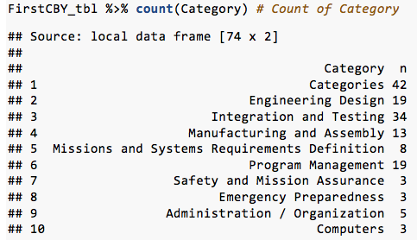
Categories
The original data frame had additional metadata, Category, Project Phase, Safety Issue, and others.

Slide 23
Correlation by Category
To find the per-document probabilities we extract theta from the fitted model’s topic posteriors

Slide 24
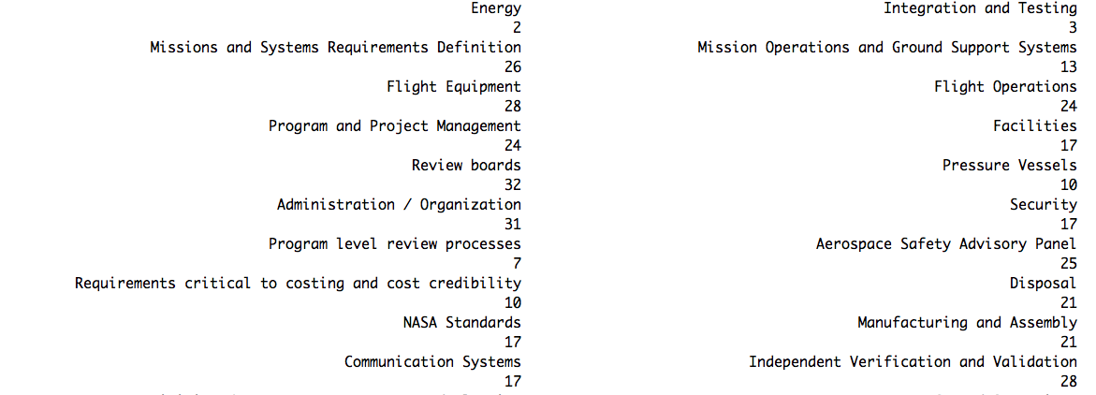
Topics for Categories
With mean theta available, it is possible to select the most representative topics of each category.
Notes:
.

Slide 25
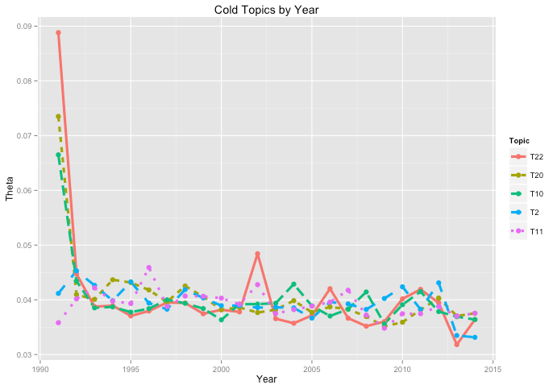
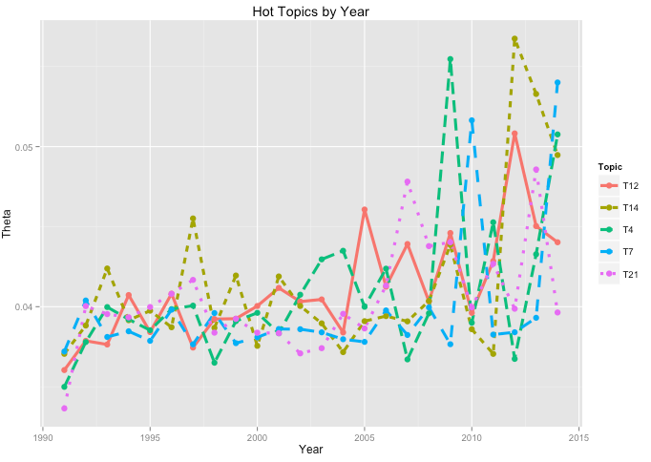
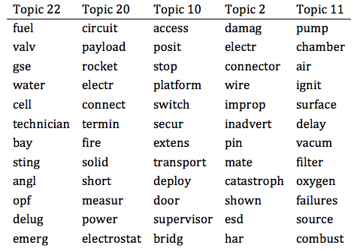
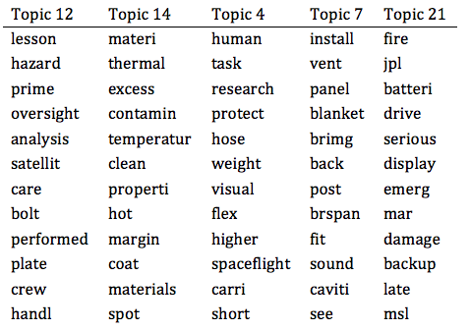
Topic Trends
Using mean of theta by years to trend topics

Slide 26
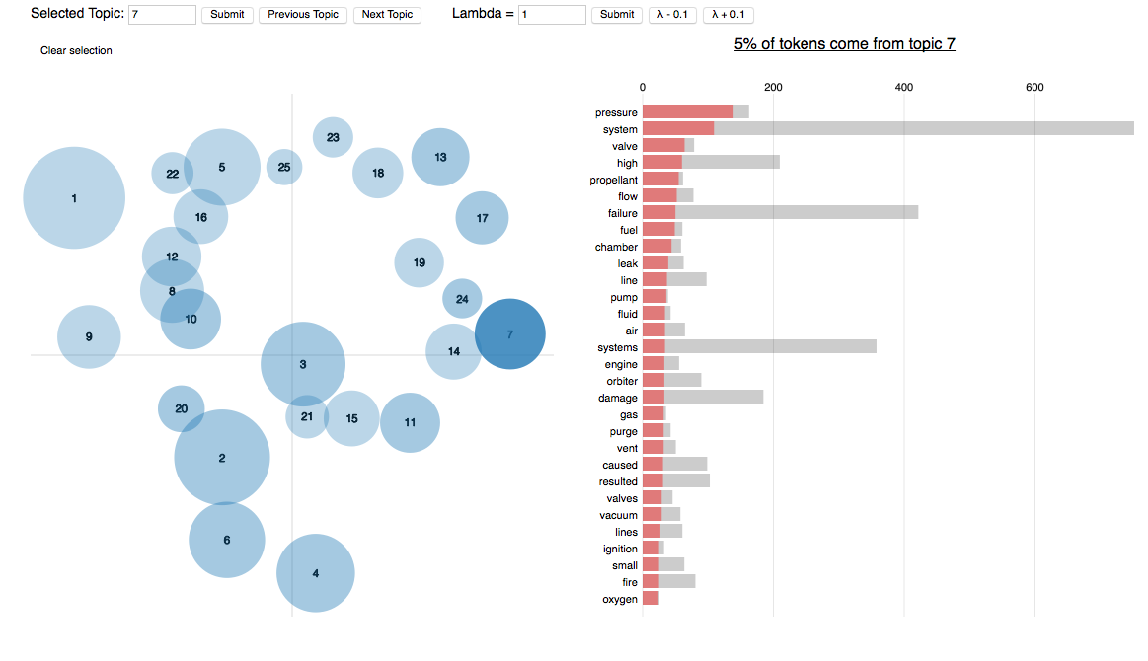
Topic visualization
Next Phase in the process, to provide users an easy method to search through the lessons.
Visualization created using LDAvis and Shiny package

Slide 27
Questions?

Slide 28


Slide 29
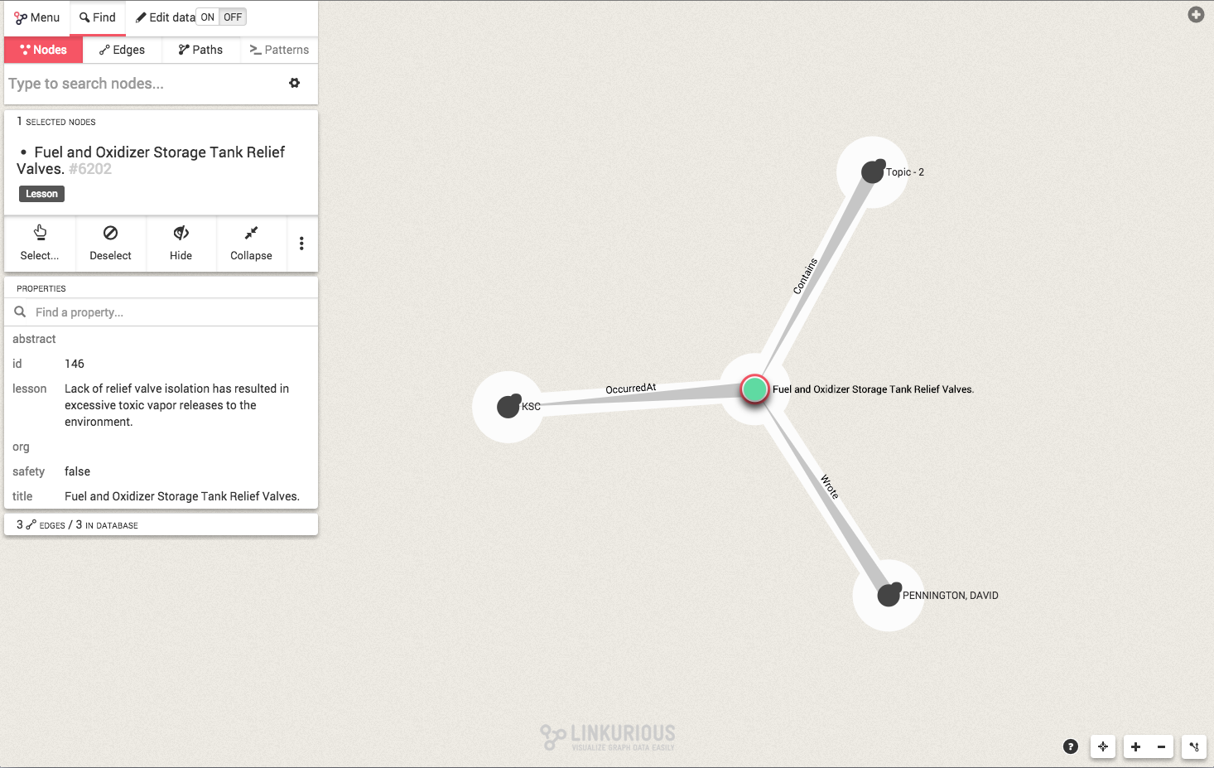

Slide 30
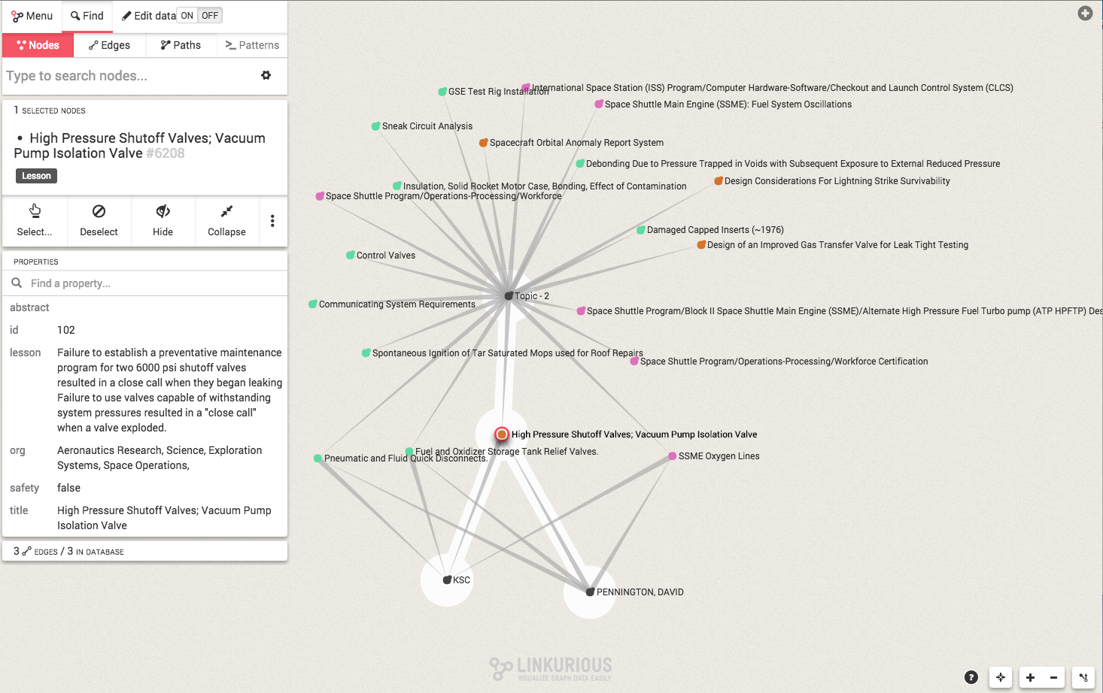

Slide 31
